Slide 1

How to Automate API Testing
(TDD * BDD) / ATDD

Slide 2
About me
Pavan Yadlapalli – Automation Architect (Humana)
Parallel programming on Super Computers
Telecom Integrations (C, C++, JSP)
Developer, Automation, devops, Cloud Native

Slide 3
About what ?
µSvc
Sample Application
TDD & BDD implementation on sample apps
Testing & Test Automation
Levels of testing
Postman
Automation & Gates
References & Links
Q&A

Slide 4
µ Services
Why? smaller, more focussed "micro" services.
Micro
Independent
Cooperating
12- Factors (http://12factor.net/)
Start with Monolith , Separate them based on demand (http://www.appcontinuum.io/)

Slide 5
Testing & Test Automation
Why Testing
Production-ready software requires testing before it goes into production
whether the developed software met the specified requirements or not and to identify the defects to ensure that the product is defect free
Why Test Automation
Continuous delivery
Building, testing and deploying an ever-increasing amount of software manually soon becomes impossible
It's obvious that testing all changes manually is time-consuming, repetitive and tedious. Repetitive is boring, boring leads to mistakes

Slide 6
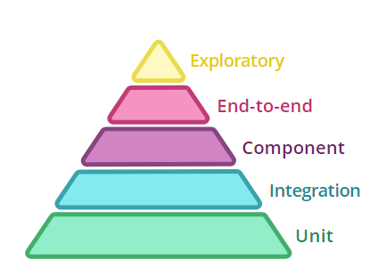
Tests
Present in our Services, we have tried coverage gates at 50%
Sometimes convoluted.
Didn’t ensure that the service will even get up.
So, Whats the correct way?
● Run the whole app’s process.
● App “doesn’t know” it’s not in production.
● Run locally, before a commit.
● High confidence that the app will get up.
● ...require external services and data bases...
https://martinfowler.com/articles/microservice-testing/#conclusion-test-pyramid

Slide 7
TDD (Just what we need) but how?
Functional Test
Unit Test
Fail
Refactor
Pass
Pass
Inside
(TDD)
Fail
Outside
(ATDD)
Refactor

Slide 8
Pros and Challenges of this Approach
encourages better design of production code
increases the testability of the product
quick feedback to developers
Automation
Requirements
Discipline
Tools

Slide 9
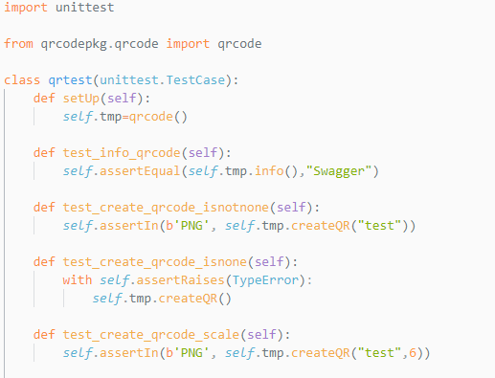
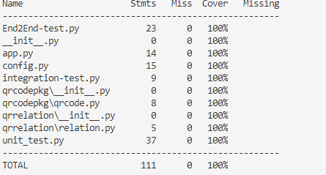
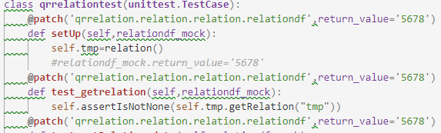
TDD Example – Just TDD
Story :
Given the Text
and then the size
when I send to REST API
Then the Response should be Qrcode as PNG File

Slide 10
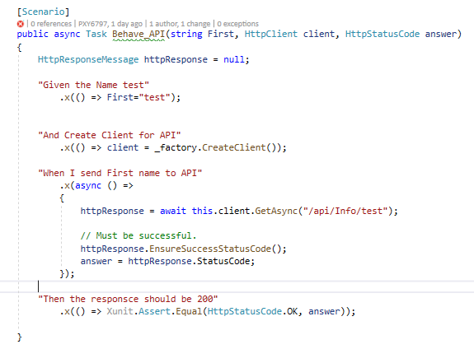
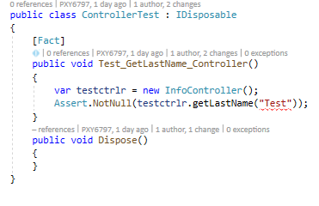
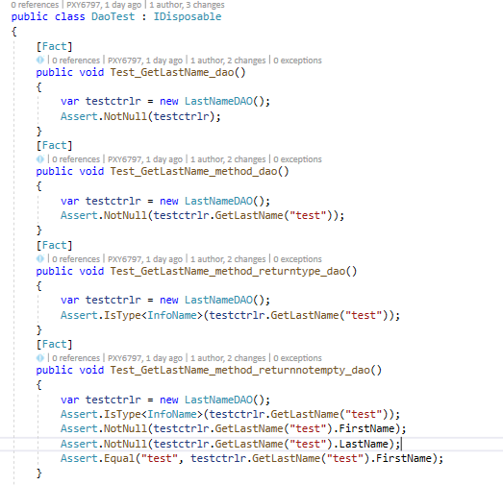
ATDD Example –TDD & BDD
Story :
Given the Name
when I send to REST API
Then API should Accept Save to DB and return 200

Slide 11
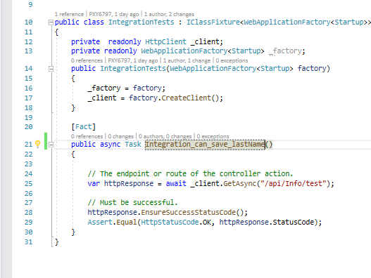
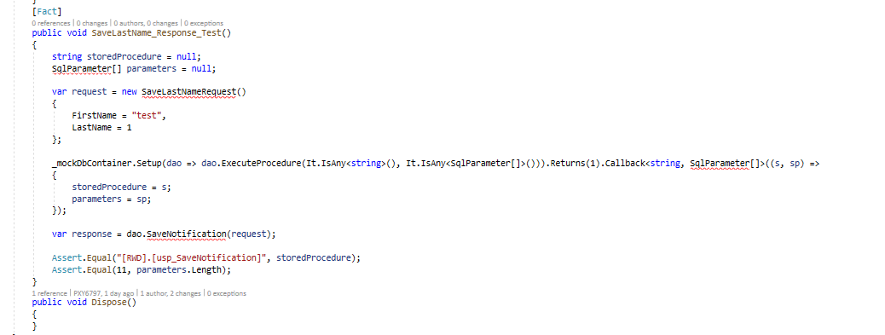
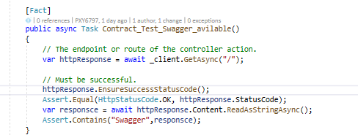
Unit, Integration, Component & Contract Test

Slide 12
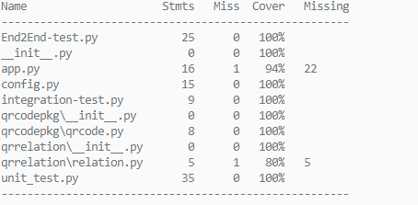
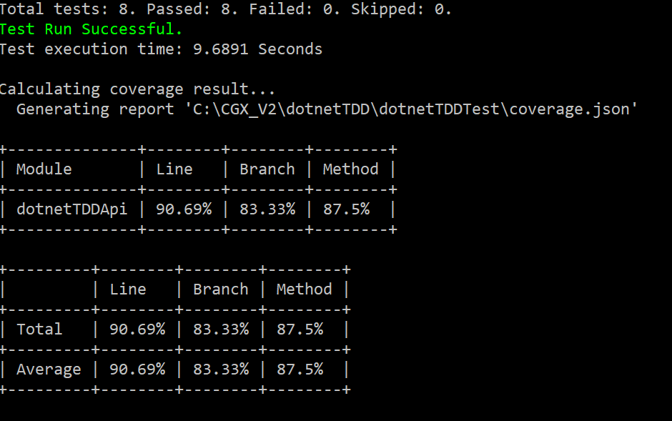
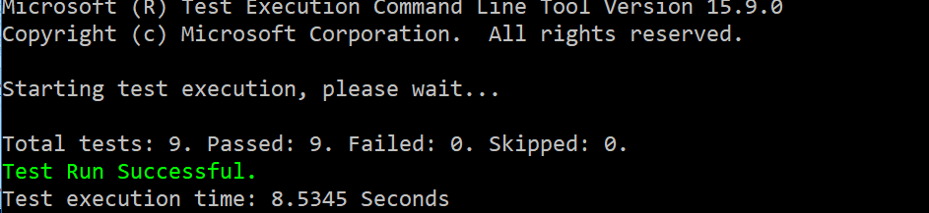
Coverage and Gates

Slide 13
Q & A ?
More about tests / microservices / stuff https://martinfowler.com/articles/microservice-testing
https://www.hindsightsoftware.com/blog/tdd-vs-bdd
https://github.com/jkcpavan/TDDPython
https://github.com/jkcpavan/dotnetcoreTDD

Slide 14
Thank You
2018.Yadlapalli@gmail.com
https://www.linkedin.com/in/pavankumar-yadlapalli-4035b369/

